Slide 1
DNA Sequencing
Sanger Sequencing
Shotgun Sequencing
Partial Digest Problem (PDP)
Next Generation Sequencing

Slide 2
Sanger Sequencing
Frederick Sanger, Cambridge, England (1977)
Amplify a sample with PCR (Polymerase Chain Reaction)
https://www.khanacademy.org/science/high-school-biology/hs-molecular-genetics/hs-biotechnology/v/the-polymerase-chain-reaction-pcr
Partition copied DNA into four groups
Each group has one of four bases starved (by dideoxyNucleotide, ddNTP)
ACGTAAGCTA with T starved produces ACG and ACGTAAGC
Run experiment with each of four bases starved, producing a ladder (all sub-fragments ending at the base)
Collect resulting fragments by length (1,000-nt)
Animations
https://video.search.yahoo.com/search/video?p=sanger+sequencing+animation&fr=yhs-invalid#id=10&vid=d19f22b72060f8eedad21b4954710f41&action=view

Slide 3
History to Next Generation Sequencing (NGS)
1977 – Frederick Sanger & Walter Gilbert independently developed the sequencing methods
1980 – they share the Nobel prize
1990 – Human Genome project (HGP) to be completed by 2005, headed by Francis Collins
1997 – Craig Venter founded Celera Genomics with the same goal
2000 – HGP completed
2010 – project to sequence 10,000 vertebrate genomes

Slide 4
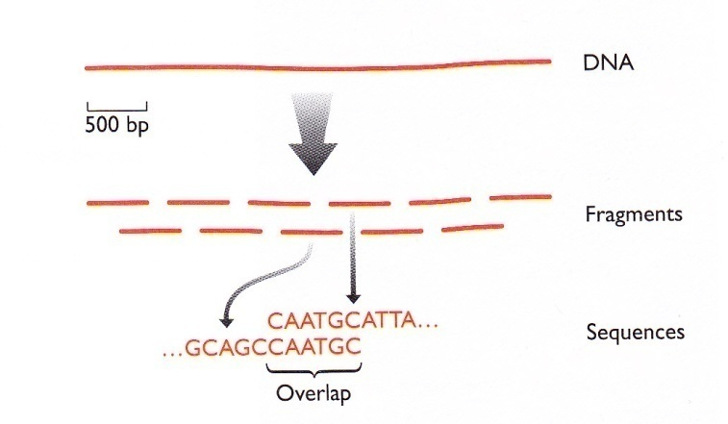
Shot-gun Method
Later, sequencing machines sequence 500-700 nt fragments, called reads
Break up DNA into fragments, amplify with PCR
Each fragment is sequenced
Use computer to search for overlap
Build a master sequence

Slide 5
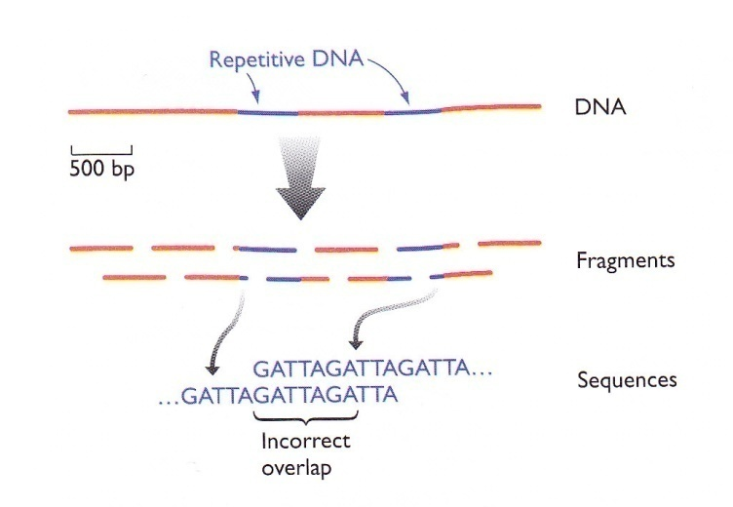
Shot-gun Method
Good for short prokaryote genomes
For n fragments, # of possible overlaps is 2n(n-1)
Repeats in sequences are problems

Slide 6
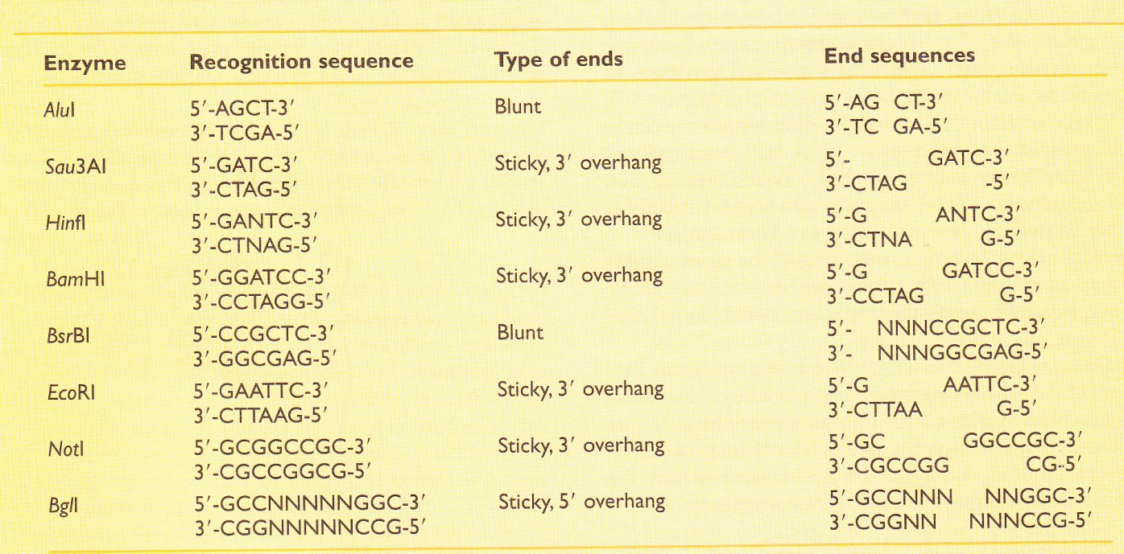
Restriction Map
Restriction endonuclease
An enzyme binding to specific DNA sequences, and making double-stranded cut at or near the sequences
Type II always cut at the same place (over 2,500 type II)
e.g., HindII cuts at GANTC

Slide 7
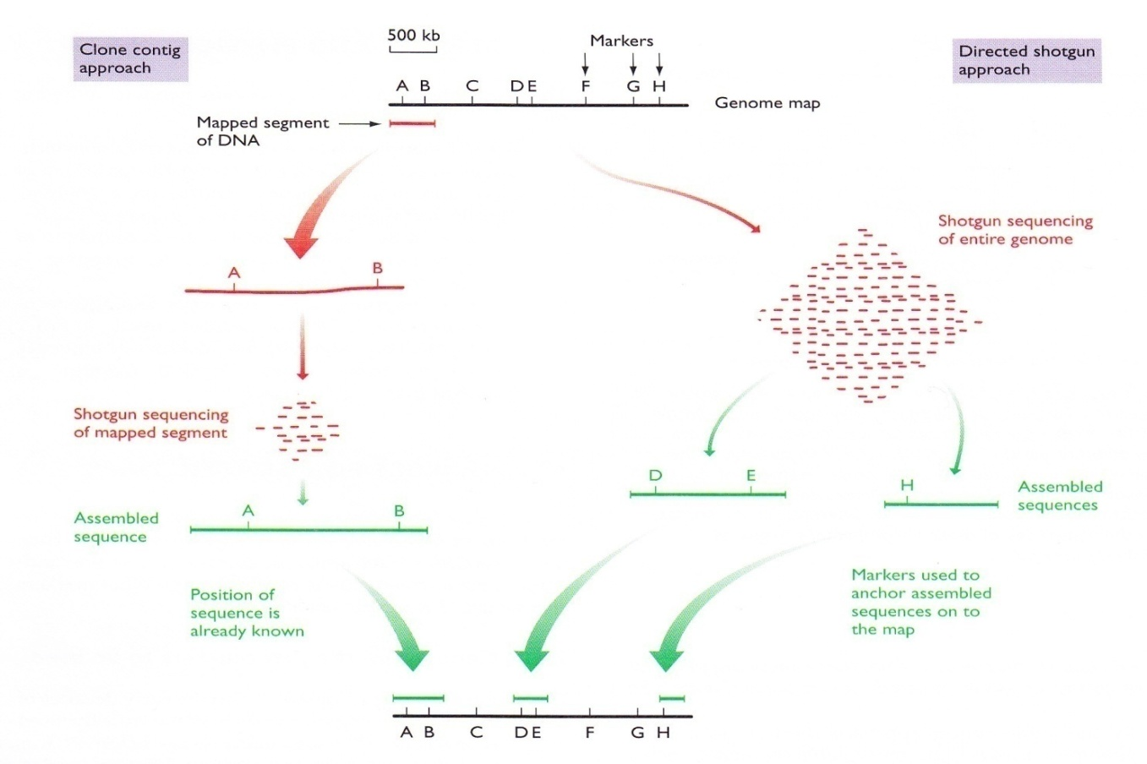

Slide 8
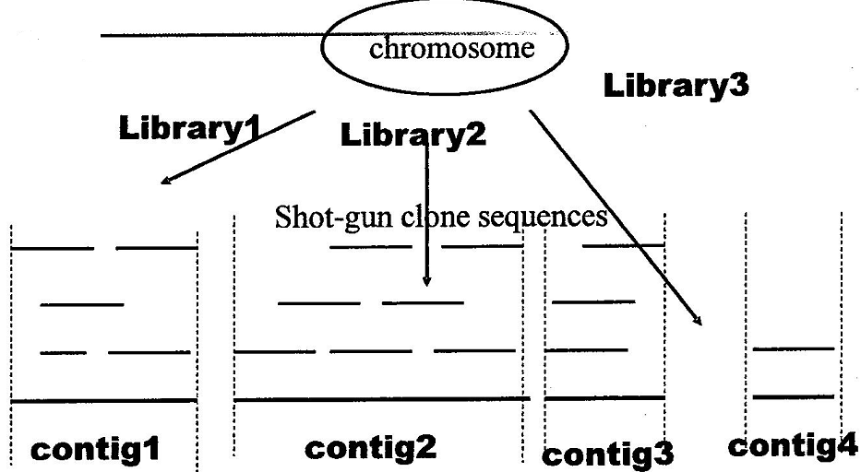
Shot-gun Sequencing

Slide 9
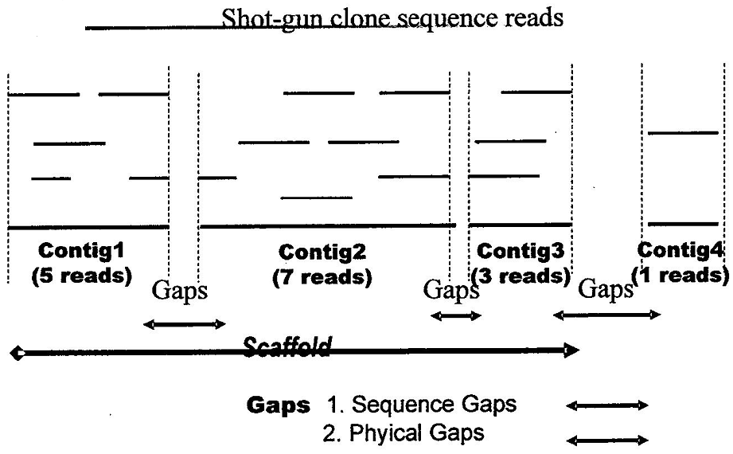
Shot-gun Sequencing

Slide 10
Complete and Partial Digest
Probability of restriction site being cut
= 1: complete digest
Distance between successive cuts is known and accurate
<1 : partial digest
Distances across more than one restriction site are generated

Slide 11
Partial Digest Problem (PDP)
X = {x₁=0, x₂, . . ., x_{n}}: an ordered set of n points on a line
ΔX = {x_{i} - x_{j}| 1 ≤ i<j ≤ n}: a multiset of pairwise distances with ( ^{n}₂) elements
Partial Digest Problem (PDP)
Given a multiset L containing ( ^{n}₂) integers of pairwise distances
Find a set X of n integers such than ΔX = L
Also, called Turnpike problem, reconstructing highway from pairs of exits
Unique set X is not always possible
e.g., if ΔA = Δ(A+v), where Δ(A+v) = {a+v|a Є A} (one set is a shift of another set)
A = {0,2,4,7,10}, Δ(A+100) = {100, 102, 104, 107, 110}
e.g., if ΔA = Δ(-A)
A = {0,2,4,7,10}, Δ(-A) = {-10, -7, -4, -2, 0}
In general, U + V and U – V are homometric

Slide 12
PDP (1)
Brute force approach
Given L,
Compute ΔX for every possible combination of X
Until X is found such that ΔX = L
Need to examine (^{M-1} _{n-2}) different set of positions
=> O(M^{n-2})
BruteForcePDP(L, n)
M ← max(L)
for every set of n-2 integers 0< x₂ < . . . <x_{n-1} <M
X ← {0 < x₂ < . . . <x_{n-1} <M }
Form ΔX from X
if ΔX = L
return X
return “No Solution”

Slide 13
PDP (2)
Brute force approach
Given L,
Identical to BruteForcePDP() except that x_{i} Є L
Need to examine (^{|L|}_{n-2}) different set of positions
=> O(M^{2n-4})
BruteForcePDP(L, n)
M <- max(L)
for every set of n-2 integers 0< x₂ < . . . <x_{n-1} <M from L
X ← {0, < x₂ < . . . <x_{n-1} <M }
Form ΔX from X
if ΔX = L
return X
return “No Solution”

Slide 14
PDP (3)
Steven Skiena, 1990
Largest in L determines the two outermost points in X
e.g. L = {2,2,3,3,4,5,6,7,8,10}
Pick 10:
X={0,10}
L = {2,2,3,3,4,5,6,7,8)
Pick 8: X={0,2,10} or X={0,8,10}. X={0,3,8,10} X={0,7,8,10}
L = {2,3,3,4,5,6,7}
Pick 7: x₃=3 should include x₃-x₂=1
X={0,2,7,10} X={0,2,3,10}
L = {2,3,4,6}
. . .

Slide 15
PLACE(L, X)
if L is empty
output X
return
y ← max(L)
if Δ(y, X) is subset of L
add y to X and remove Δ(y, X) from L
PLACE(L,X)
remove y from X and
add Δ(y, X) to L
if Δ(width-y, X) is subset of L
add width-y to X and
remove Δ(width-y, X)
PLACE(L, X)
remove width-y from X and
add Δ(width-y, X) to L
return
PartialDigest(L)
width ← max(L)
DELETE(width, L)
X ← {0, width}
PLACE(L, X)
[ Δ(y, X): multiset of distances between a point y and all points in set X]

